Slide 1

Comparative analysis of machine learning methods for analyzing security practice in electronic health records’ logs.
By: Prosper K. Yeng, Muhammad A. Fauzi, Bian Yang:
Norwegian University of Science and Technology
University of Tromsø, The Arctic University of Norway

Slide 2
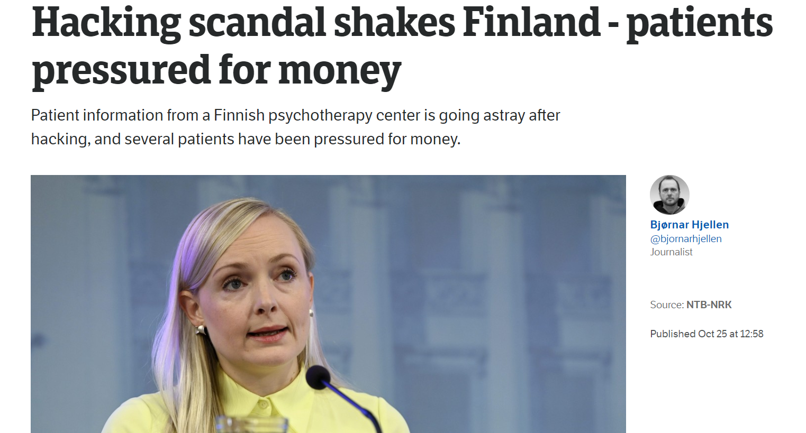

Slide 3
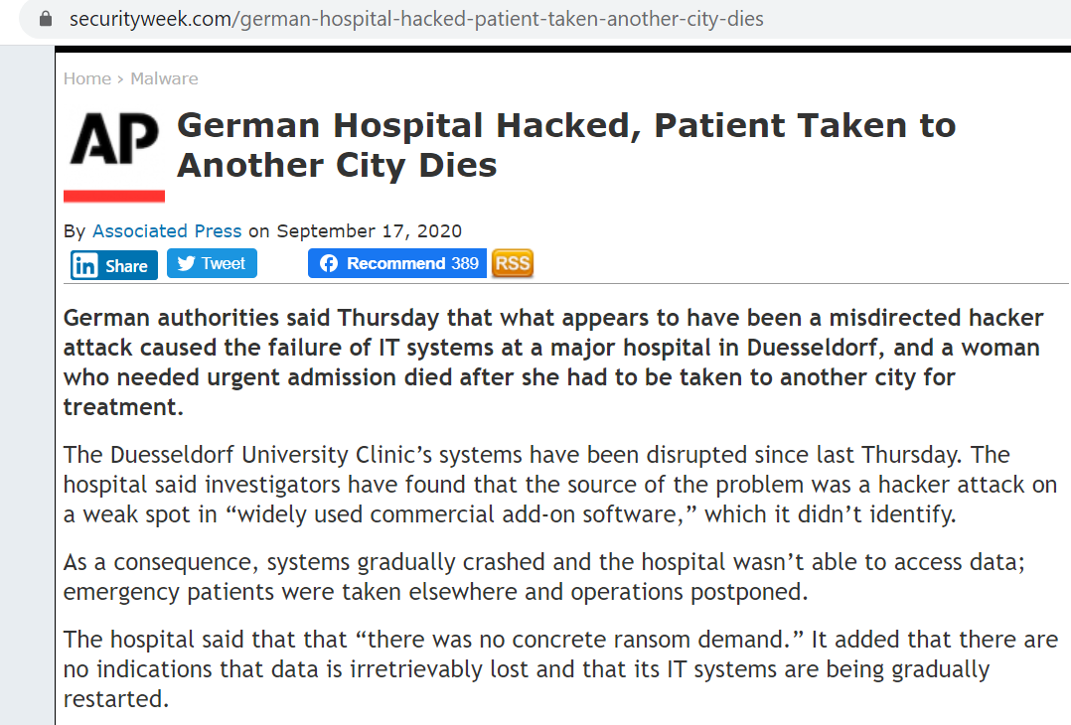

Slide 4
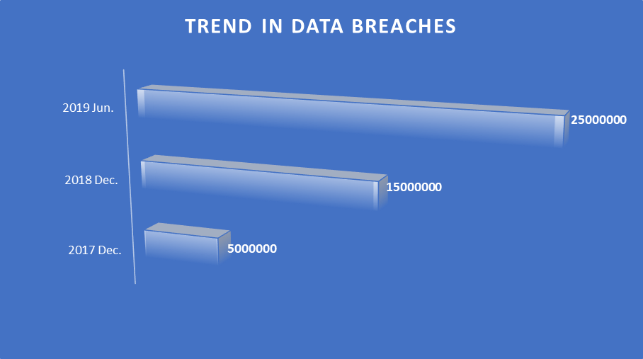

Slide 5
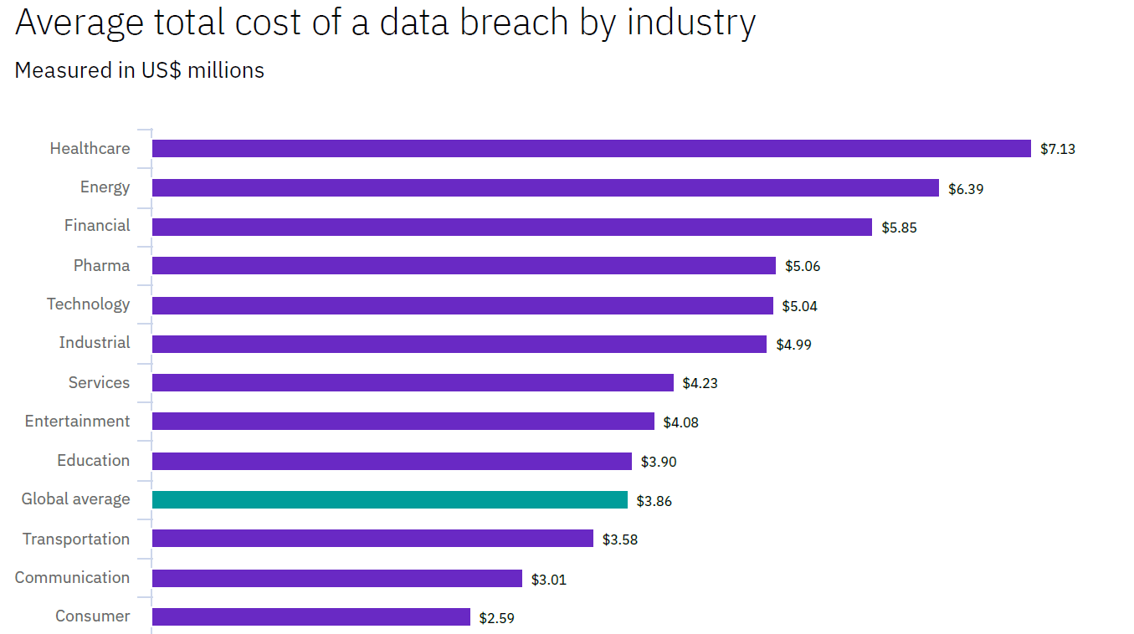

Slide 6
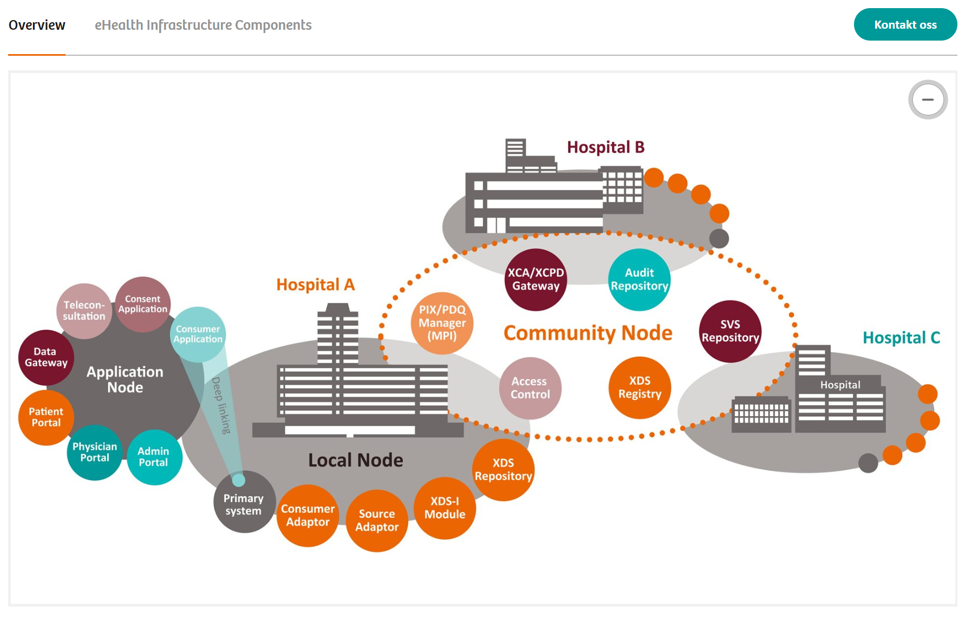
More attention on tech. measures than the human firewall!
Norwegian eHealth infrastructure(Siemens-healthineers, 2018)
security governance configuration,
security planning and policies,
risk management,
And other technology controls
Firewalls
DMZs
IDS/IPS
Antivirus
Other Technologies

Slide 7
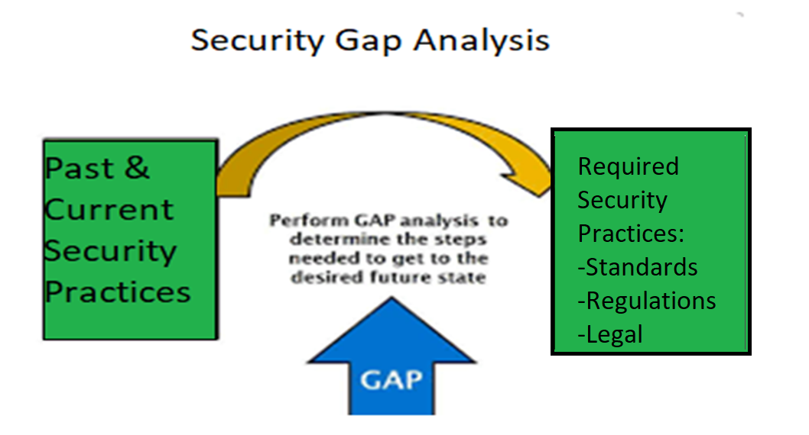
General Goal of HSPAMI

Slide 8
Data Driven and AI Approach

Slide 9
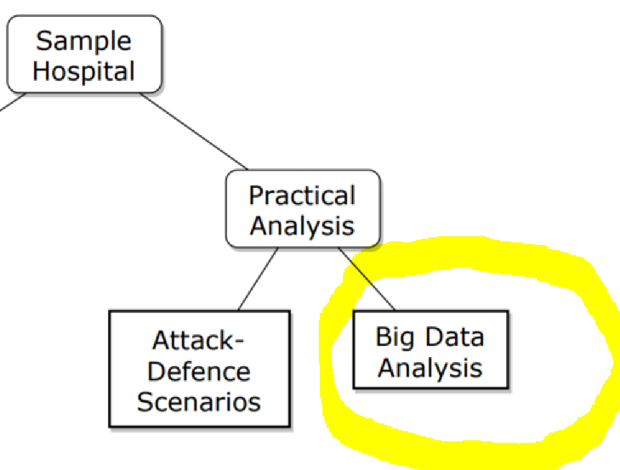
Security practice analysis in the context of Big data
Data sources
EHR logs
Network logs
Host based activity logs
Etc.

Slide 10

Security requirement in EHR
Case study: Norway

Slide 11
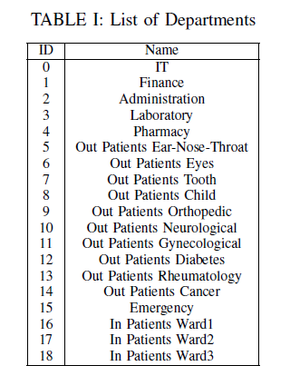

Slide 12
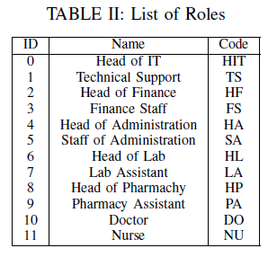

Slide 13
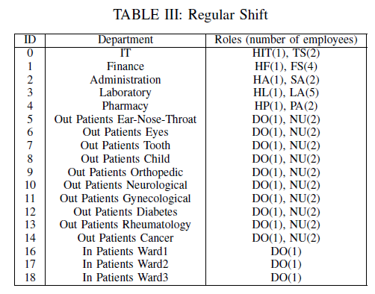
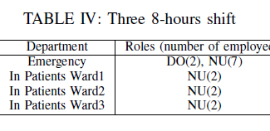

Slide 14
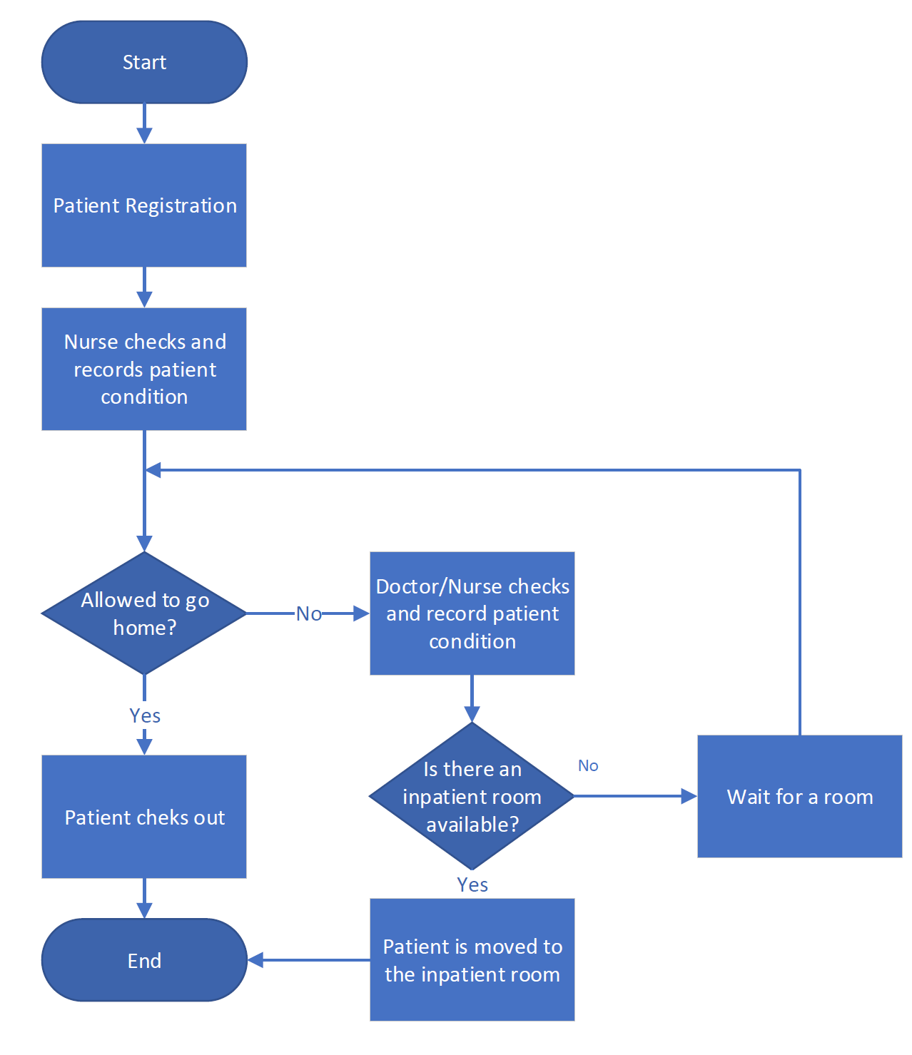
Inpatient flow

Slide 15
EHR rules by the healthcae code of conduct in Norway:
Accessing patients records is only allowed for therapeutic purposes
Access is given to only those with an official need to use,
Self-authorization or ”break the glass” scenarios is allowed but the necessary measures should be provided,
All of the activities related to access of the personal health data (register, update, edit, delete etc )must be logged

Slide 16
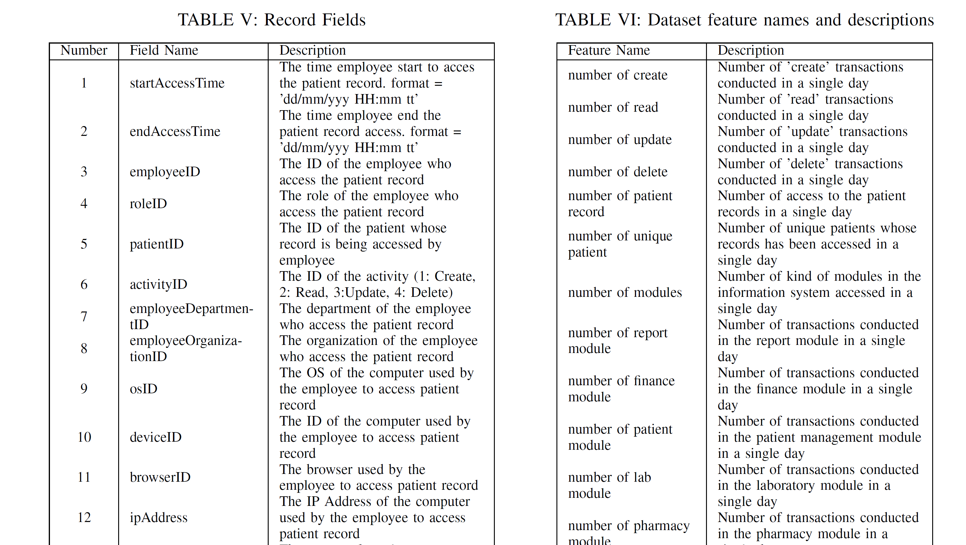
Attributes and features

Slide 17

Abnormal data simulation
Access by identity theft.
The attacker will access more data than legitimate users
Attackers sometimes not follow the flows.

Slide 18
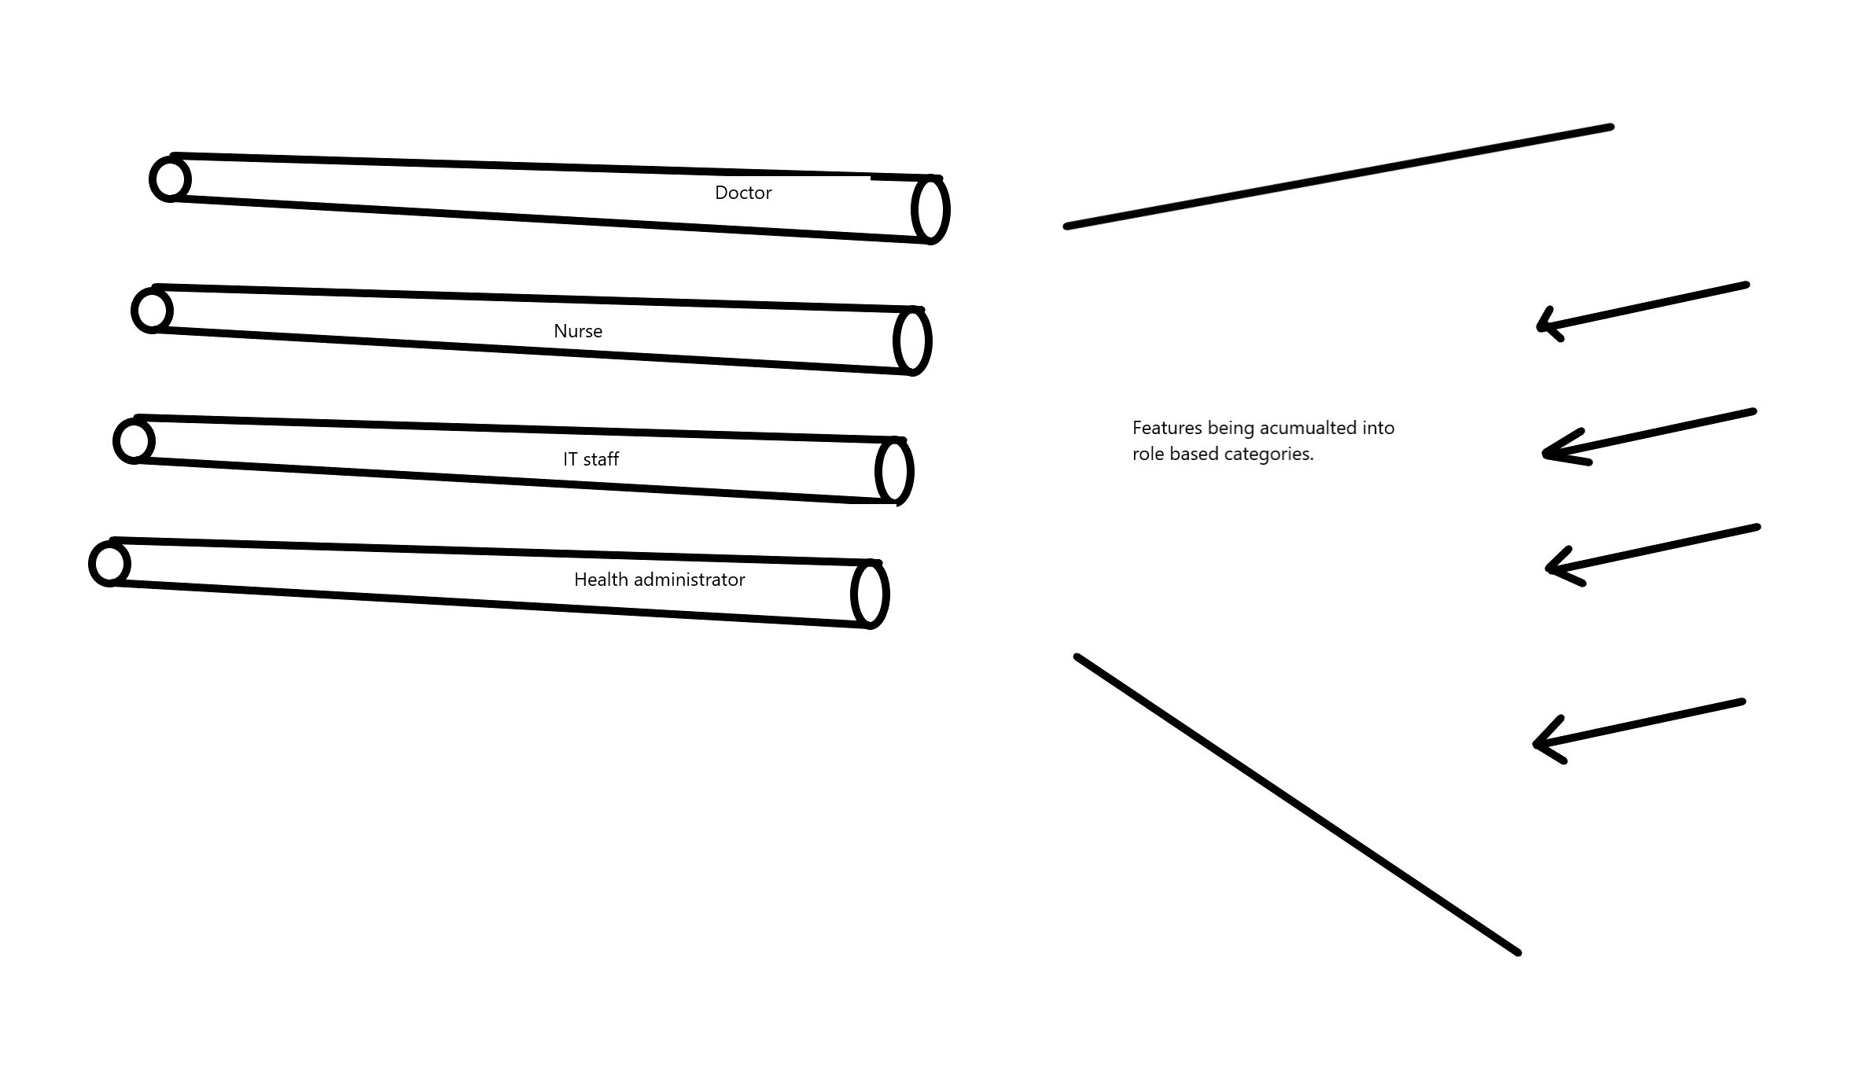
Role classification model
classify the cumulative user activity in a single day into one of the 12 categories
The model was used to classify the cumulative activity of a user in a single
Day
The model was then trained and validated with cross-fold validation

Slide 19
Future works
future works on further processing the anomalies to detect malicious activities.
Additional, as labeled real data can be difficult to get, it is also important to compare unsupervised methods for the detection of anomalies and maliciousness in the context of big data.

Slide 20
Reference
Foroughi, F. and P. Luksch. Observation Measures to Profile User Security Behaviour. in 2018 International Conference on Cyber Security and Protection of Digital Services (Cyber Security). 2018.
ISO, ISO 27799:2016(en), Health informatics Information security management in health using ISO/IEC 27002. 2016.
Nurse, J.R.C., et al. Understanding Insider Threat: A Framework for Characterising Attacks.IEEE Security and Privacy Workshops. 2014.
Boddy, A., et al. A Study into Detecting Anomalous Behaviours within HealthCare Infrastructures. in 2016 9th International Conference on Developments in eSystems Engineering. 2016.
Walker-Roberts, S., M. Hammoudeh, and A. Dehghantanha, A Systematic Review of the Availability and Efficacy of Countermeasures to Internal Threats in Healthcare Critical Infrastructure. IEEE Access, 2018. 6: p. 25167-25177.
e-helse, D.f. Implementation of GDPR in health care sector in Norway. 2019; Available from: https://ehelse.no/personvern-og-informasjonssikkerhet/eus-personvernforordning/implementation-of-gdpr-in-health-care-sector-in-norway.
LOVDATA, Lov om behandling av helseopplysninger ved ytelse av helsehjelp (pasientjournalloven) - Kapittel 3. Taushetsplikt, innsynsrett og rett til å motsette seg behandling av helseopplysninger. 2019.
omsorgsdepartementet, H.-o., Act of 18 May 2001 No. 24 on Personal Health Data Filing Systems and the Processing of Personal Health Data (Personal Health Data Filing System Act), in 042041-990016. 2006, regjeringen.no.
Supervision, N.B.o.H., The Act of 2 July 1999 No. 63 relating to Patients’ Rights (the Patients’ Rights Act) in 63. 1999.
Neuhaus, C., A. Polze, and M. M R Chowdhuryy, Survey on Healthcare IT Systems: Standards, Regulations and Security. 2011.
GDPR.Report, Businesses at risk due to unidentified network traffic according to global survey - GDPR.Report. 2018.
Hipaa Journal, Healthcare Data Breach Statistics. 2019.
Norwegian Centre for E-health Research. Diabetesdagboka.no. 2018; Available from: http://www.diabetesdagboka.no/en/.
EUR-Lex, The European Parliament and the Council of the European Union, Regulation (EU) 2016/679, EU, Editor. 2016.
Pedersen, S. and G. Hartvigsen, Lessons learned from 25 years with telemedicine in Northern Norway. 2015

Slide 21

Thank You For Your Attention!
Questions?
PROSPER K. YENG
PhD. Candidate
Norwegian University of Science and Technology
E-mail: Prosper.Yeng@ntnu.no

